Slide 1
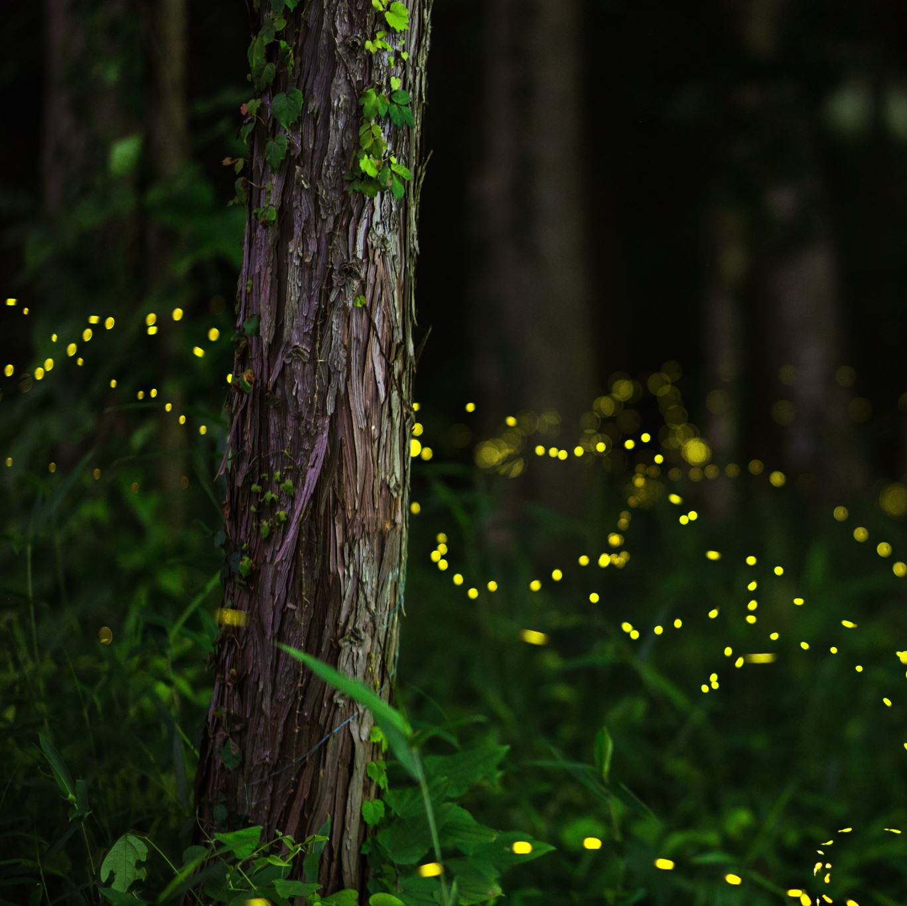
A Midsummer Night’s Dream
By William Shakespeare
Jan Susina – ENG 375
March 22, 2022
PowerPoint created by Olivia Godoy

Slide 2
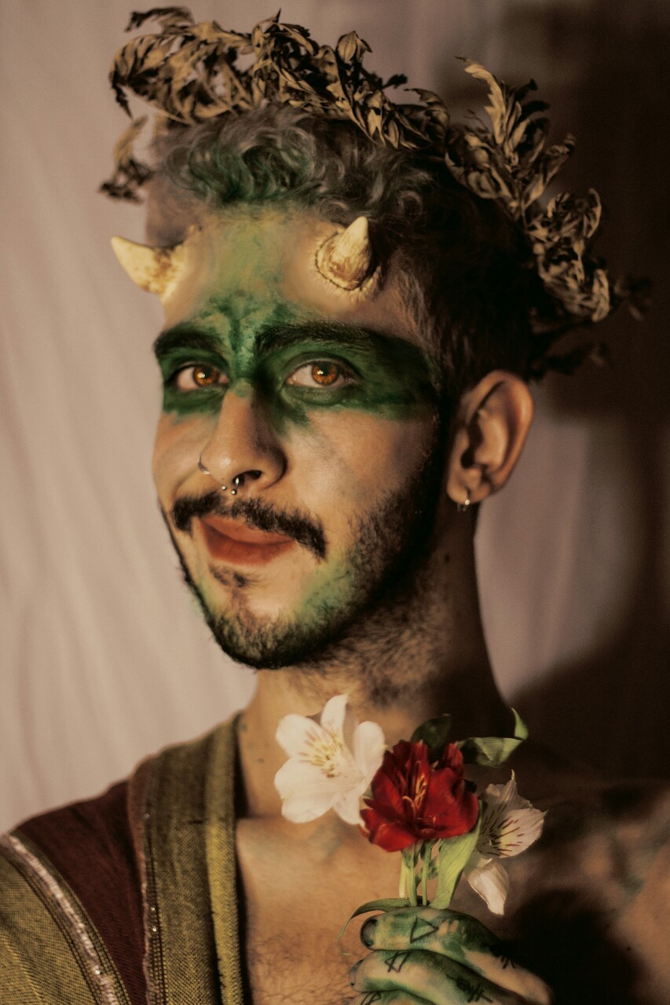
“Lord, what fools these mortals be!”
–Puck (Act III.2; 46)

Slide 3
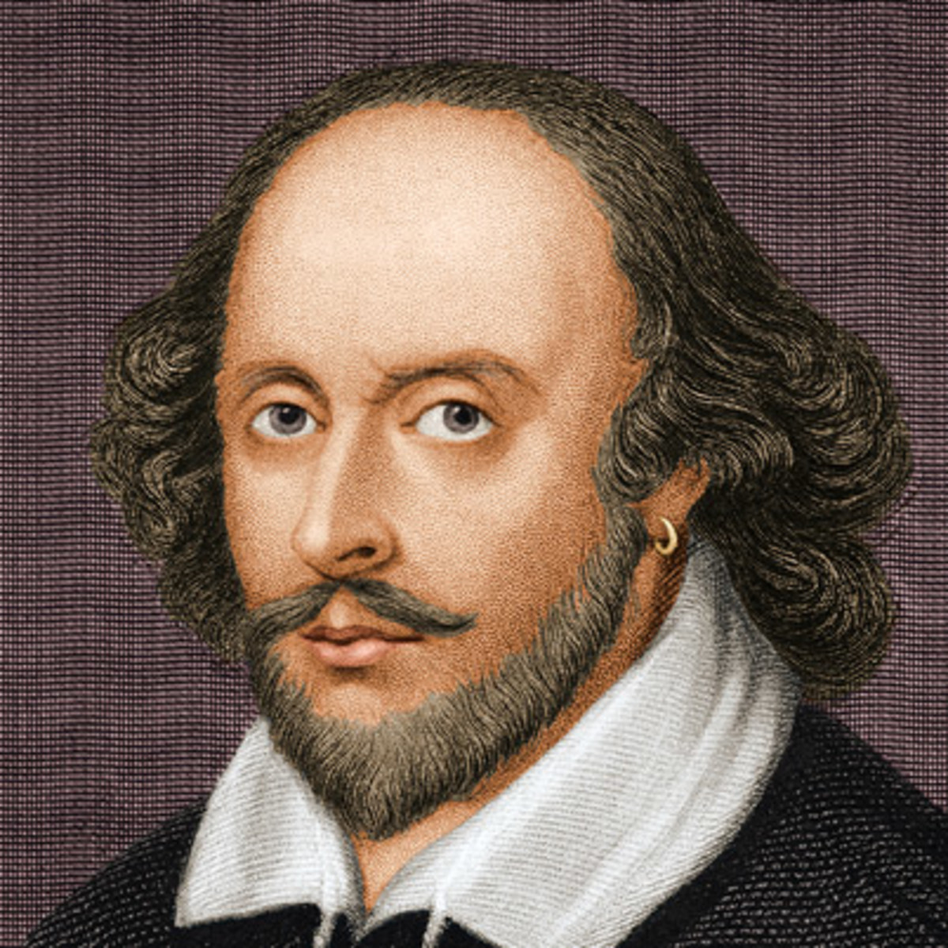
Shakespeare
April 23, 1564 (birth)
April 23, 1616 (death)
Marriage – 1582 (xvii)
Shakespeare – 18
Ann Hathaway – 26
People say little is known of Shakespeare, but more is known about him than any other writer of the era (xvi)

Slide 4
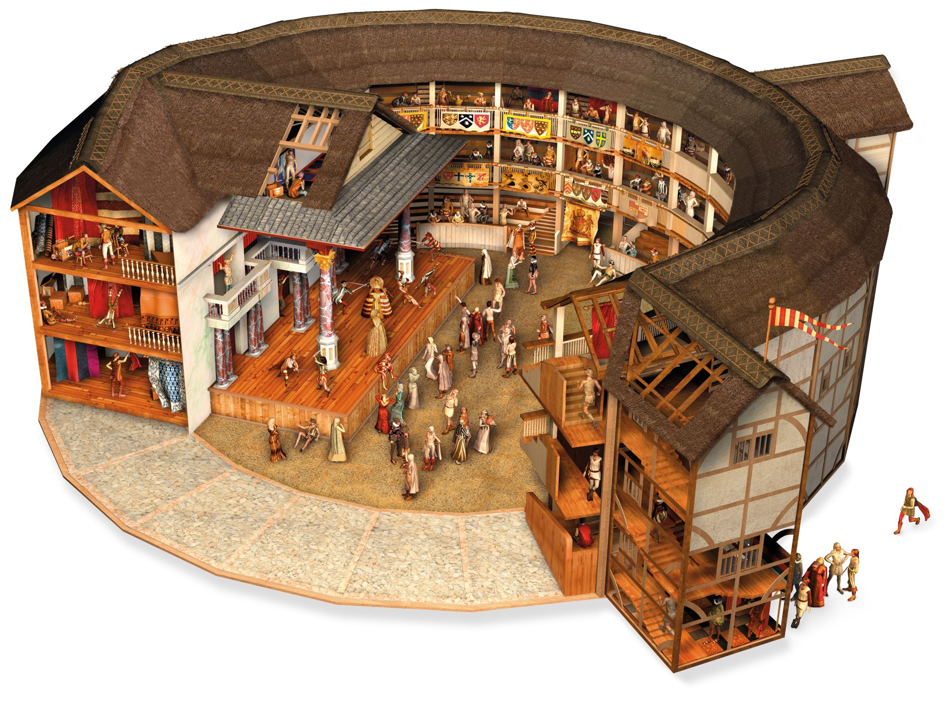
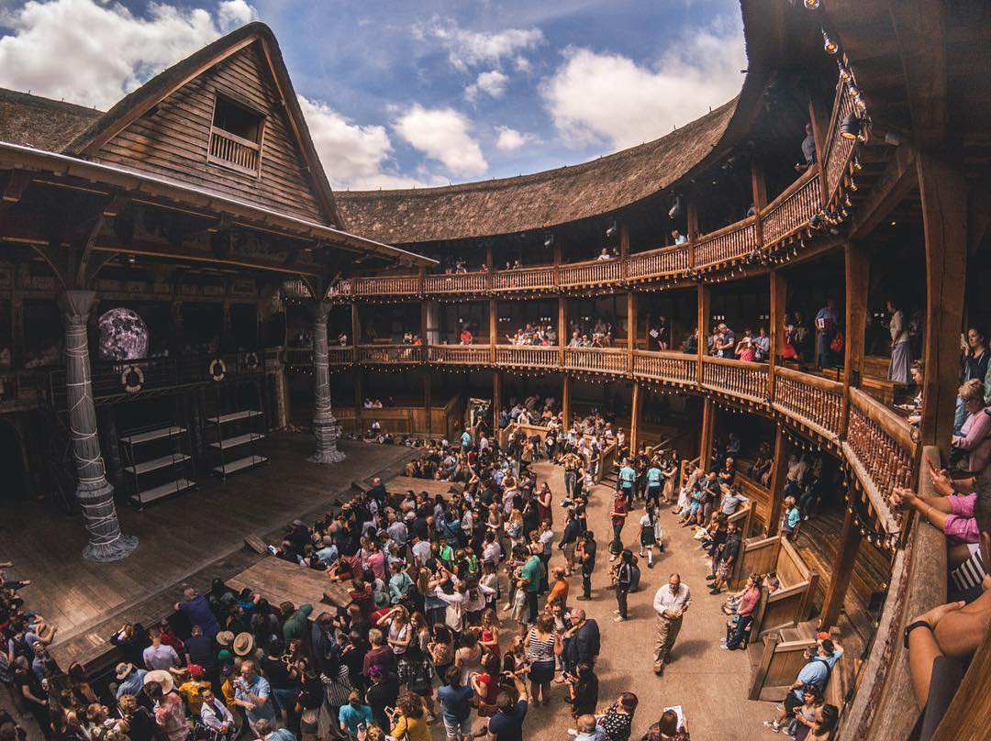
Introduction
10% of population went to the theater regularly (x)
Up to 2,500 people in the audience (x)
37 plays
150 sonnets
Sexy Shakespeare sonnets (135/136)

Slide 5
The Complications of Romantic Love
Lysander to Hermia (Act I.1; 8)
“Ay me, for aught that I could ever read, could ever hear by tale or history the course of true love never did run smooth:
But either was in the blood.”
Hermia and Lysander go “Into the woods”
-followed by Demetrius
-followed by Helena

Slide 6
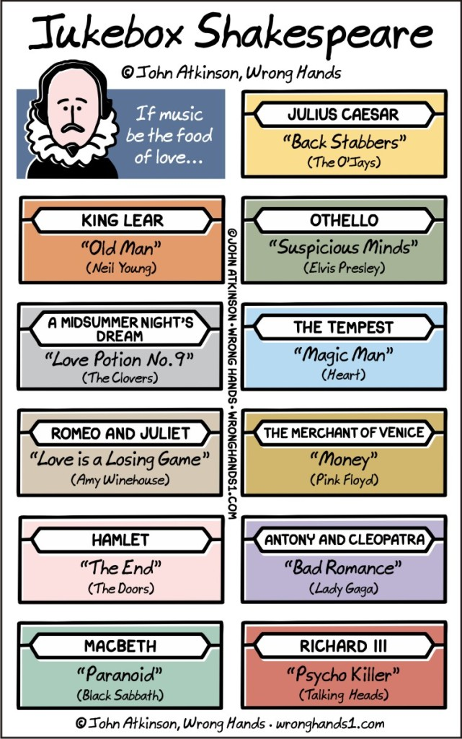

Slide 7
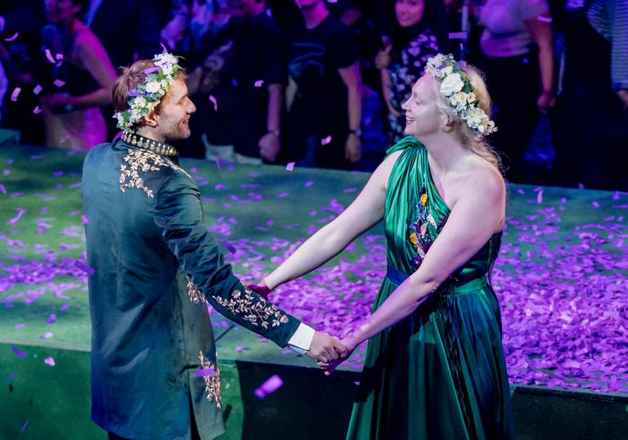
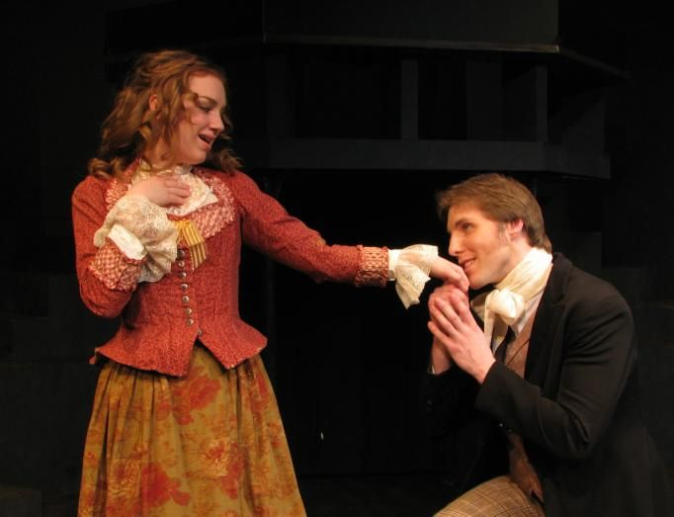
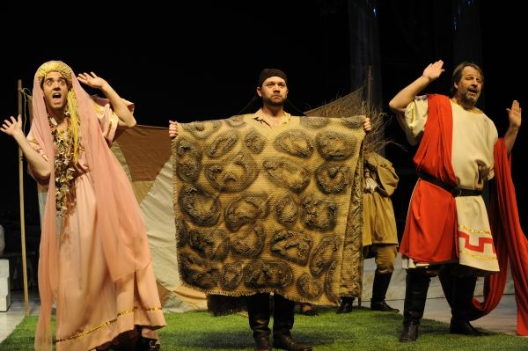
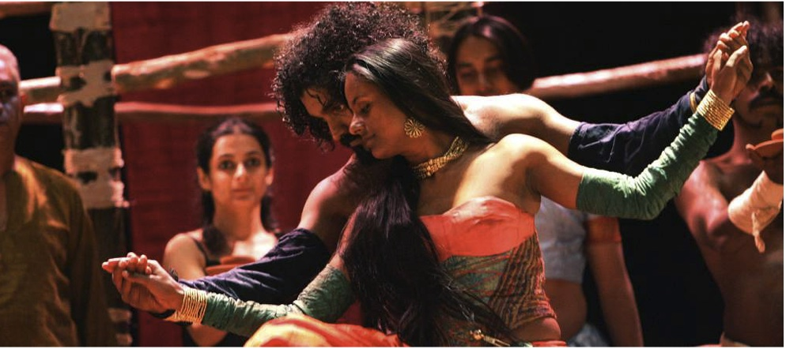
Four Groups in the Play
PASSION
INDIAN BAY
Young Lovers:
Hermia & Lysander
Demetrius & Helena
Long-term relationship:
Titania & Oberon
King and Queen of Fairyland
Rustics and their play:
“Pyramus and Thisbe” (76-85)
Comic reworking of Romeo+Juliet
REASON
Middle-aged lovers:
Theseus & Hippolyta

Slide 8
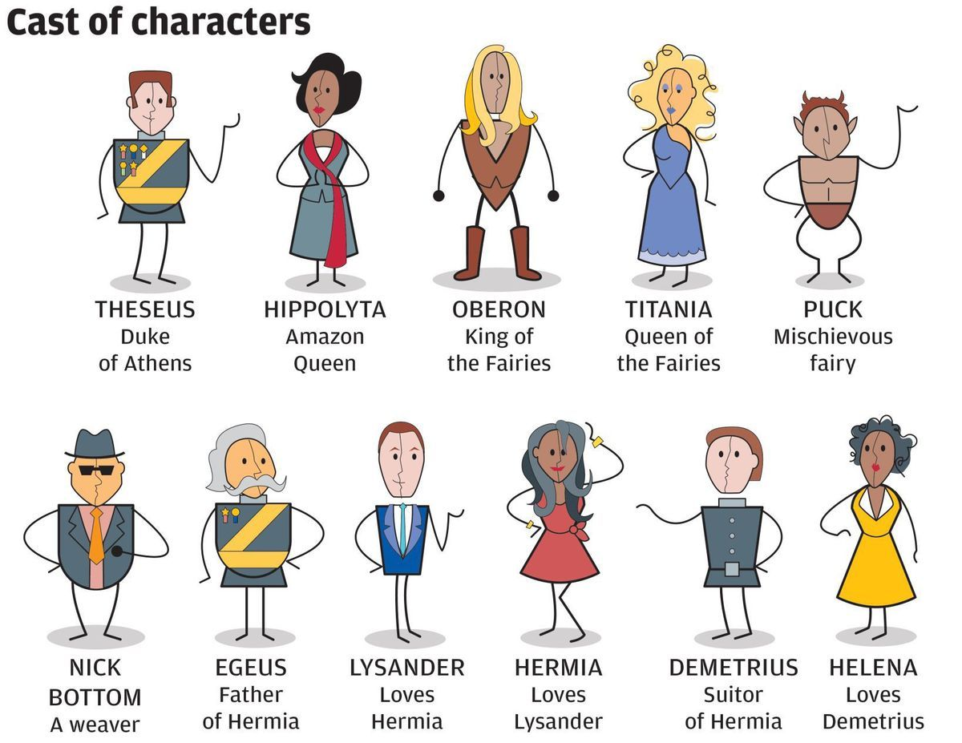
Shakespeare’s A Midsummer Night’s Dream (1600)
Hermia loves Lysander… BUT
Hermia’s father, Egeus, wants Hermia to marry Demetrius…. BUT
Demetrius loves Hermia… BUT
Helena loves Demetrius

Slide 9
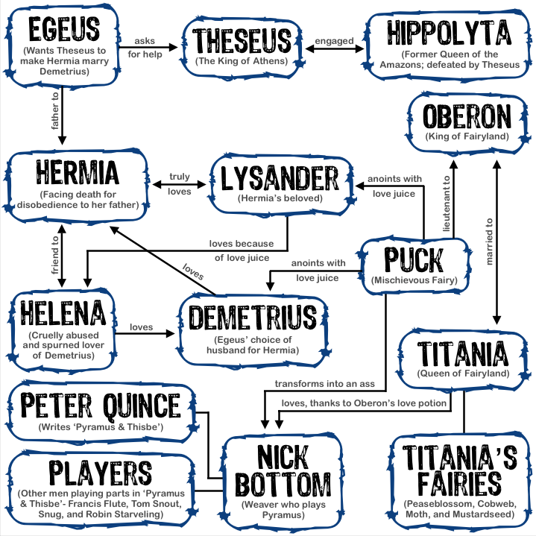

Slide 10
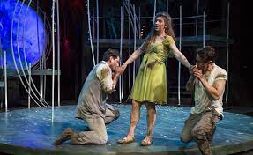
Shakespeare’s A Midsummer Night’s Dream (1600)
Going into
the Woods
In the
Woods
Lysander and Demetrius
Hermia
Lysander and Demetrius
Helena
nobody
Thanks to Puck and the love potion
everybody

Slide 11
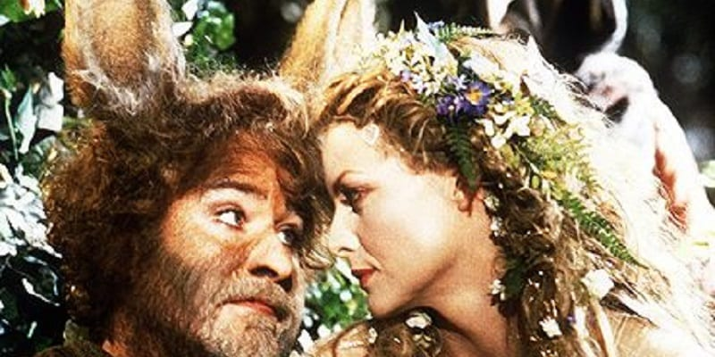
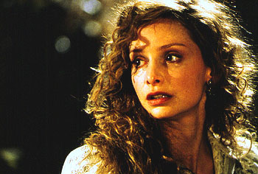
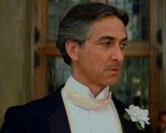
“A Midsummer Night’s Dream”
Helena:
“Love looks not with the eyes but with the mind,
And therefore is winged cupid painted blind.”
(Act I.11; 12)
Bottom to Titania:
“And yet, to say the truth, reason and love keep little company nowadays.”
(Act III.1; 39)
Theseus:
“ The lunatic, the lover, and poet
Are of imagination all compact.”
(Act V.1; 71-72)

Slide 12
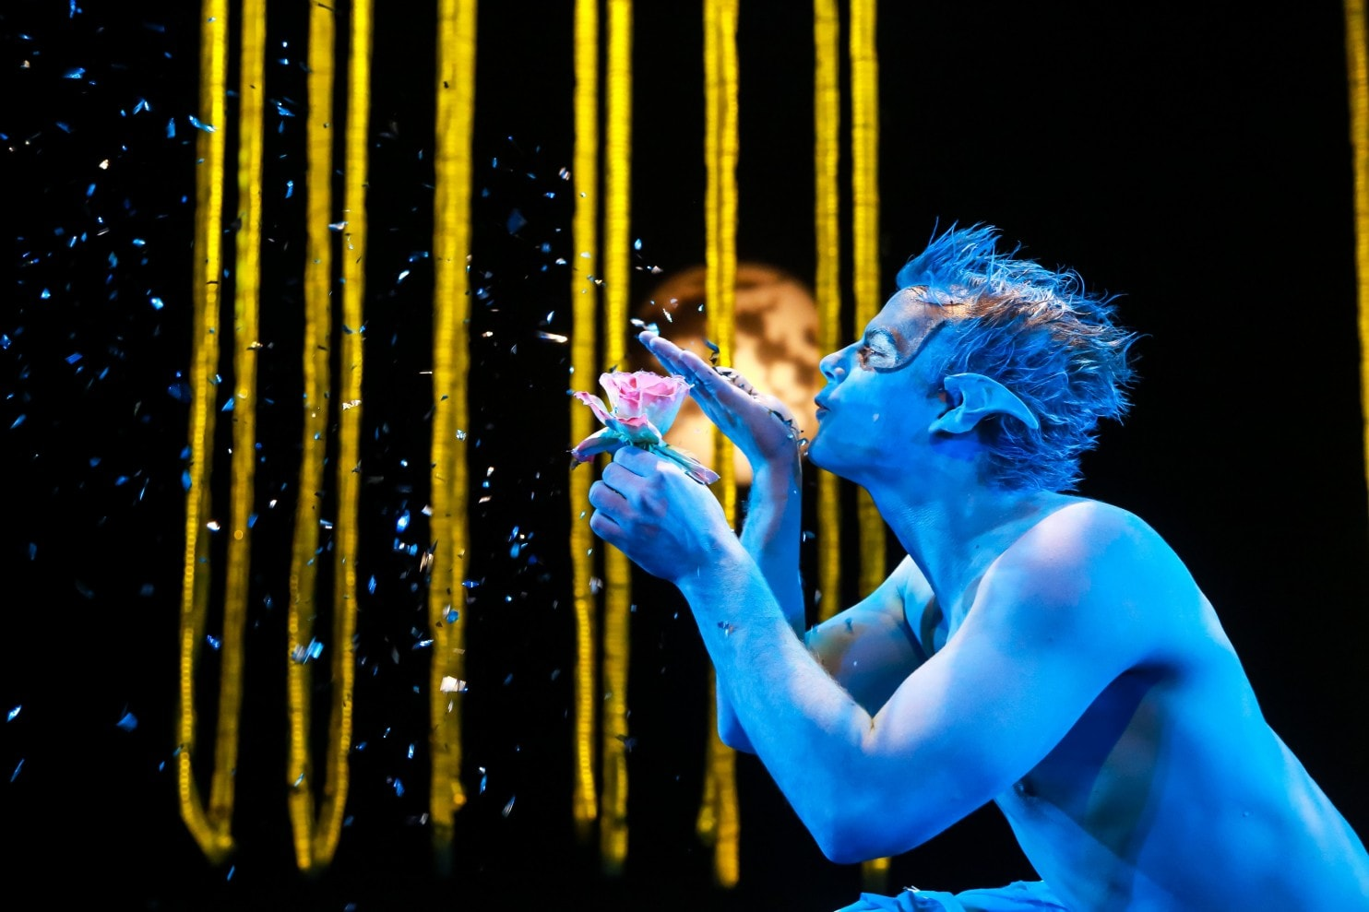
At the beginning of the play:
Both Lysander + Demetrius love Hermia… BUT
Both Lysander + Demetrius love Helena… BUT
Puck corrects the situation
By the middle of the play:
Conclusion:
Hermia loves Lysander
Helena loves Demetrius

Slide 13
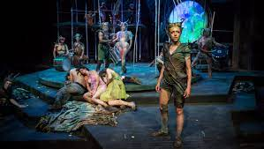
“Jack shall have Jill,
Naught shall go ill”
-Puck (Act III.2; 60)

Slide 14
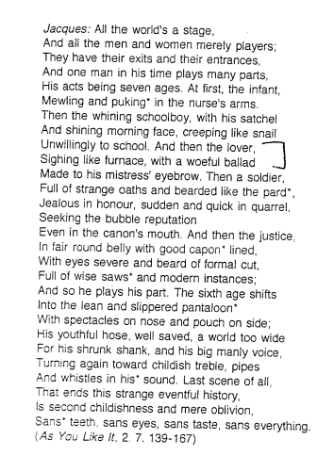
Theseus’s Speech
(Act V.1; 71-72)
The lunatic, the lover and the poet
Are of imagination all compact:
One sees more devils than vast hell can hold,
That is, the madman: the lover, all as frantic,
Sees Helen's beauty in a brow of Egypt:

